Slide 1
LPC2148 MICROCONTROLLER
Dr. Kavya B S
Dept. of ECE
MIT
Bangalore

Slide 2
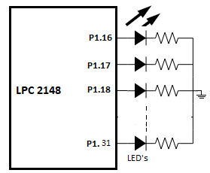
LPC2148 Port Programming
LED blinking
Assume that 16 LEDS are connected to PORT1. Write a program to blink the LEDs

Slide 3
LPC2148 Port Programming
LED blinking
Assume that 16 LEDS are connected to PORT1. Write a program to blink the LEDs
Method 1: using IOxSET and IOxCLR registers
/* start the main program */
int main()
{
PINSEL2 = 0x000000; //Configure the P1 Pins for GPIO;
IO1DIR = 0xFFFFFFFF; //Configure the P1 pins as OUTPUT;
while(1)
{
IO1SET = 0xFFFF0000; // Make all the Port pins as high
delay_ms(1000);
IO1CLR = 0xFFFF0000; // Make all the Port pins as low
delay_ms(1000);
}
}
#include <lpc214x.h>
void delay_ms(unsigned int count)
{
unsigned int j=0,i=0;
for(j=0; j<count; j++)
{
for(i=0; i<3000; i++);
}
}

Slide 4
LPC2148 Port Programming
LED blinking
Assume that 16 LEDS are connected to PORT1. Write a program to blink the LEDs
Method 2: in which IOxPIN register is used for both setting and clearing the PORT pins.
#include <lpc214x.h>
void delay_ms(unsigned int count)
{
unsigned int j=0,i=0;
for(j=0;j<count;j++)
{
for(i=0;i<3000;i++);
}
}
/* start the main program */
int main()
{
PINSEL2 = 0x000000; //Configure the P1 Pins for GPIO;
IO1DIR = 0xFFFFFFFF; //Configure the P1 pins as OUTPUT;
while(1)
{
IO1PIN = 0xFFFFFFFF; // Make all the Port pins as high
delay_ms(1000);
IO1PIN = 0x00000000; // Make all the Port pins as low
delay_ms(1000);
}
}

Slide 5
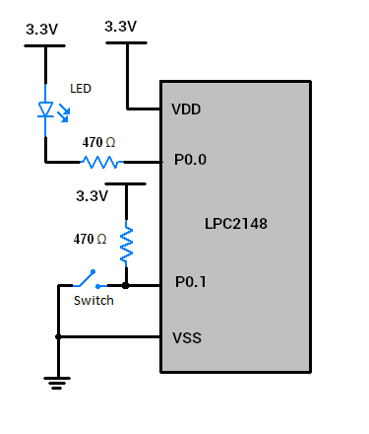
LPC2148 Port Programming
A LED is interfaced to P0.0 and a switch is interfaced to P0.1. Write a simple program for turning LED ON or OFF depending on the status of the pin.
#include <lpc214x.h>
#include <stdint.h>
int main(void)
{
PINSEL0 = 0x00000000; /* Configuring P0.0 to P0.15 as GPIO */
IO0DIR = 0x00000001; /* Make P0.0 bit as output bit, P0.1 bit as an input pin */
while(1)
{
if ( IO0PIN & (1<<1) ) /* If switch is open, pin is HIGH */
{
IO0SET = 0x00000001; /* Turn off LED */
}
else /* If switch is closed, pin is LOW */
{
IO0CLR = 0x00000001; /* Turn on LED */
}
}
}

Slide 6
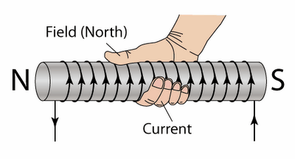
Stepper Motor Interfacing with LPC2148
Introduction
It is a brushless DC Motor
Control signals are applied to stepper motor to rotate it in steps.
Its speed of rotation depends upon rate at which control signals are applied.
There are various stepper motors available with minimum required step angle.
Stepper motor is made up of mainly two parts: a stator and rotor
Stator is of coil winding
Rotor is mostly permanent magnet or ferromagnetic material.
Working Principle of Stepper Motor
Current flowing through winding creates magnetic North and South pole on coil.
If we wrap our right-hand fingers around coil in the direction of current flowing through the coil, then the thumb direction indicates the magnetic North Pole.

Slide 7
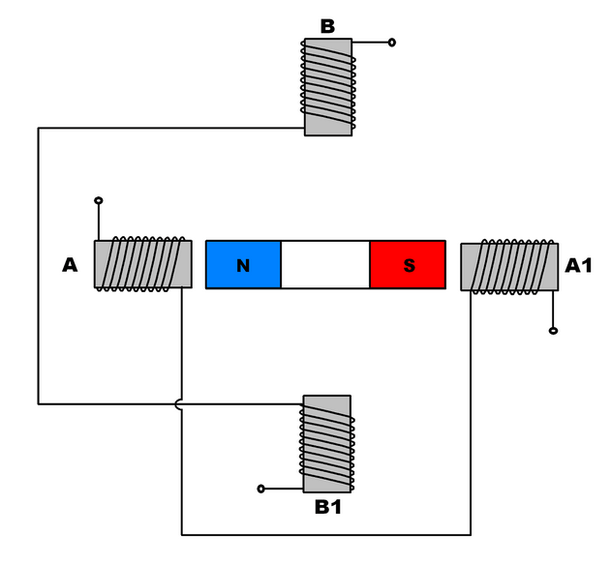
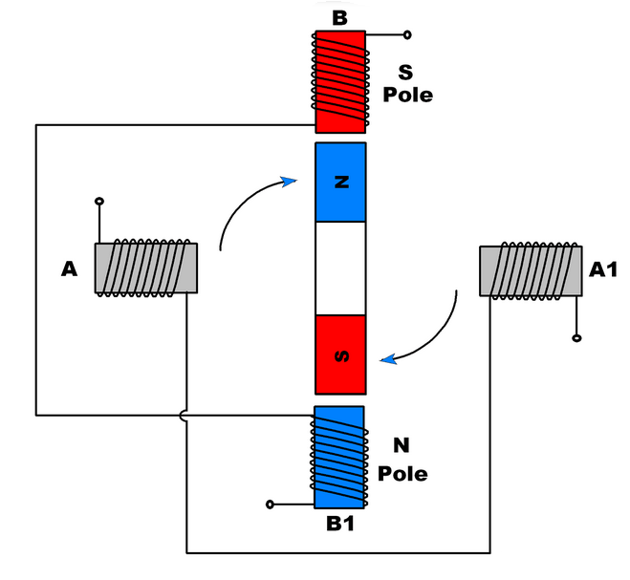
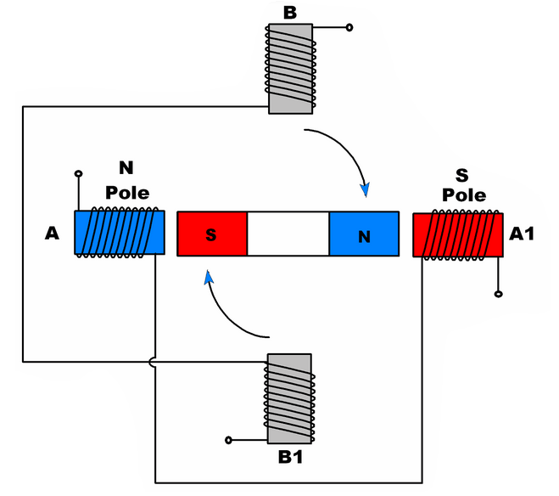
Stepper Motor Interfacing with LPC2148
Working Principle
Stepper motor rotates in steps
Two winding, A and B are the stator of motor.
Permanent magnet having North and South poles is rotor of the motor.

Slide 8
Stepper Motor Interfacing with LPC2148
Step Angle
Minimum angle that stepper motor will cover within one move/step.
Number of steps required to complete one rotation depends upon step angle.
Example: If step angle is of 45° then 8 steps are required to complete one rotation
Depending upon stepper motor configuration, step angle varies e.g. 0.72°, 1.8°, 3.75°, 7.5°, 15° etc.
Classification of Stepper motors:
Depending upon winding arrangement
- Unipolar Stepper Motor
- Bipolar Stepper Motor
Depending upon construction
- Permanent Magnet Stepper Motor
- Variable Reluctance Stepper Motor
- Hybrid Stepper Motor

Slide 9
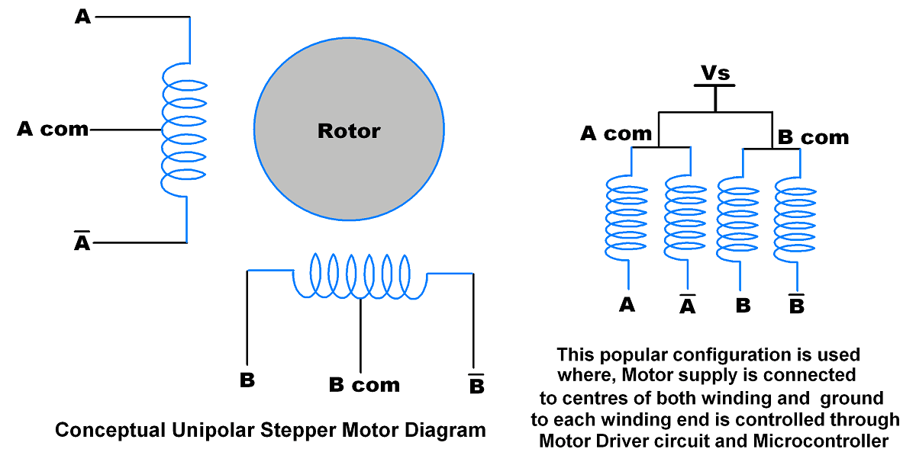
Stepper Motor Interfacing with LPC2148
Unipolar Stepper Motor
Unipolar Stepper Motor has centre tapped winding with 5 (If both centres are connected internally) or 6 wires.
Generally, these centre tapped connections are connected to the power supply.
By providing ground path to the winding leads we can allow the flow of current through each half of coil which create magnetic poles.
By altering poles sequentially, we can rotate rotor accordingly.
The current is unidirectional in unipolar motor.
Due to centre tap, each winding is divided i.e. current flows through half of winding.
Due to its centre tap arrangement, we do not need to change current direction to change magnetic pole on winding. Here we just need to alter ground connection at winding ends.

Slide 10
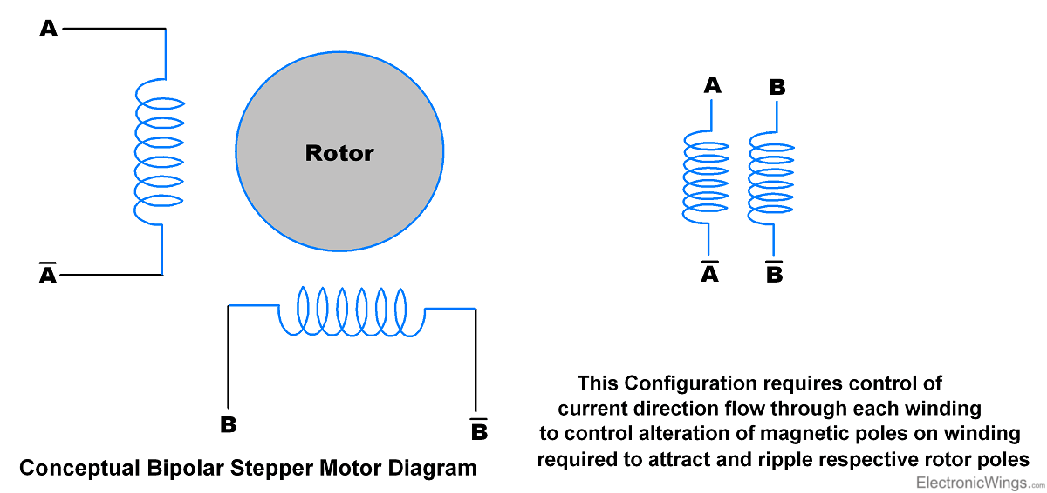
Stepper Motor Interfacing with LPC2148
Bipolar Stepper Motor
Bipolar stepper Motor has no centre tap connection.
Normally it is of two windings i.e. 4 wire end
Current flows through full winding of stator.
The current is Bidirectional in Bipolar stepper motor i.e. we need to alter current direction through winding to alter magnetic pole of that winding.

Slide 11
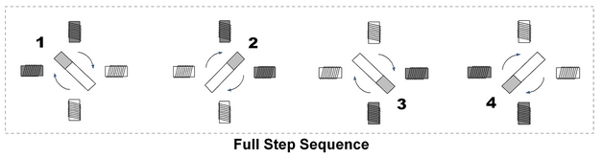
Stepper Motor Interfacing with LPC2148
How to Rotate Stepper Motor
Stepper motor rotates in steps and for continuous or limited angle rotation we need to provide sequential steps.
There are two step sequences used to rotate Stepper Motor
Full Step Sequence
Half Step Sequence
Full Step Sequence
Here motor moves through its basic step angle.
At a time two coils are excited.
Step | A | B | C | D
1 | 1 | 0 | 0 | 1
2 | 1 | 1 | 0 | 0
3 | 0 | 1 | 1 | 0
4 | 0 | 0 | 1 | 1

Slide 12
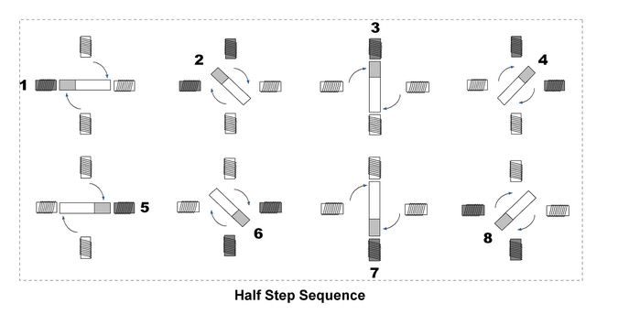
Stepper Motor Interfacing with LPC2148
How to Rotate Stepper Motor
Half Step Sequence
Here motor moves half of its basic step angle.
Half step can be achieve by exciting both current and next coil.
Step | A | B | C | D
1 | 0 | 0 | 0 | 1
2 | 1 | 0 | 0 | 1
3 | 1 | 0 | 0 | 0
4 | 1 | 1 | 0 | 0
5 | 0 | 1 | 0 | 0
6 | 0 | 1 | 1 | 0
7 | 0 | 0 | 1 | 0
8 | 0 | 0 | 1 | 1

Slide 13
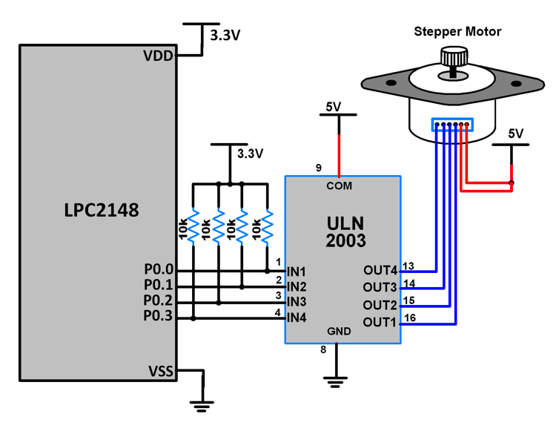
Stepper Motor Interfacing with LPC2148

Slide 14
Stepper Motor Interfacing with LPC2148
#include <LPC214x.h>
#include <stdio.h>
void delay(int);
unsigned char STEP[] = {0x09, 0x08, 0x0C, 0x04, 0x06, 0x02, 0x03, 0x01};
int main(void)
{
unsigned int i=0;
PINSEL0 &= 0xFFFFFF00; // P0.3 - P0.0 as GPIO
IODIR0 = 0x0000000F; // P0.3 - P0.0 as Output
while(1){
while (STEP[i] != '\0')
{
IOSET0 = STEP[i];
delay(1);
IOCLR0 = STEP[i];
delay(1);
i++;
}
i=0;
}
return 0;
}
void delay(int n)
{
int i,j;
for(i=0;i<n;i++)
{
for(j=0;j<0x3FF0;j++) {;}
}
}

Slide 15
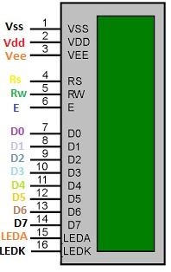
LCD Interfacing with LPC2148
The LCDs are normally used in different embedded syustems due to its low cost, easy access and flexibility to get programmed.
Almost each and every electronic device has this kind of display
LCD that has sixteen column and two rows so it is known as 16 x 2 LCD modules.
LCD also available in different arrangements like (8 x 1), (10 x 2), (16 x 1), but the 16 x 2 is normally used in embedded systems.

Slide 16
LCD Interfacing with LPC2148
Pin Number | Symbol | Pin Function
1 | VSS | Ground
2 | VCC | +5v
3 | VEE | Contrast adjustment (VO)
4 | RS | Register Select(RS) 0:Command, 1: Data
5 | R/W | Read/Write, R/W=0: Write & R/W=1: Read
6 | EN | Enable. Falling edge triggered
7 | D0 | Data Bit 0
8 | D1 | Data Bit 1
9 | D2 | Data Bit 2
10 | D3 | Data Bit 3
11 | D4 | Data Bit 4
12 | D5 | Data Bit 5
13 | D6 | Data Bit 6
14 | D7 | Data Bit 7/Busy Flag
15 | A/LED+ | Back-light Anode(+)
16 | K/LED- | Back-Light Cathode(-)

Slide 17
LCD Interfacing with LPC2148
Sr. No. | Hex Code | Command to LCD
1 | 01 | Clear display screen
2 | 02 | Return home
3 | 04 | Decrement cursor (shift cursor to left)
4 | 06 | Increment cursor (shift cursor to right)
5 | 05 | Shift display right
6 | 07 | Shift display left
7 | 08 | Display off, cursor off
8 | 0A | Display off, cursor on
9 | 0C | Display on, cursor off
10 | 0E | Display on, cursor blinking
11 | 0F | Display on, cursor blinking
12 | 10 | Shift cursor position to left
13 | 14 | Shift cursor position to right
14 | 18 | Shift the entire display to the left
15 | 1C | Shift the entire display to the right
16 | 80 | Force cursor to beginning ( 1st line)
17 | C0 | Force cursor to beginning ( 2nd line)
18 | 38 | 2 lines and 5×7 matrix

Slide 18
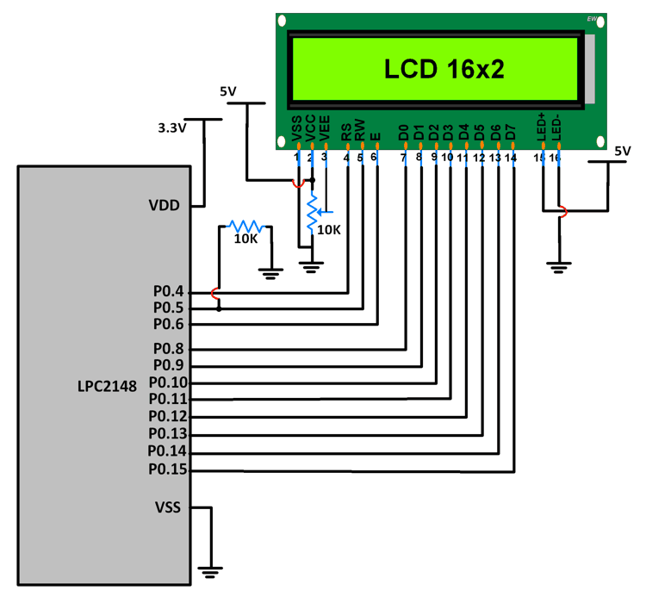
LCD Interfacing with LPC2148

Slide 19
LCD Interfacing with LPC2148
#include <lpc214x.h>
#include <stdio.h>
void delay_ms(int j) /* Function for delay in milliseconds */
{
int x,i;
for(i=0;i<j;i++)
{
for(x=0; x<6000; x++); /* loop to generate 1 millisecond delay with Cclk = 60MHz */
}
}

Slide 20
LCD Interfacing with LPC2148
void LCD_CMD(char command)
{
IO0PIN = ( (IO0PIN & 0xFFFF00FF) | (command<<8) ); /* Put command on data pins */
delay_ms(2);
IO0SET = 0x00000040; /* EN = 1 */
IO0CLR = 0x00000030; /* RS = 0, RW = 0 */
delay_ms(2);
IO0CLR = 0x00000040; /* EN = 0, RS and RW unchaned(i.e. RS = RW = 0) */
delay_ms(5);
}
void LCD_INIT(void)
{
IO0DIR = 0x0000FFF0; /* P0.8 to P0.15 LCD Data. P0.4,5,6 as RS RW and EN */
delay_ms(20);
LCD_CMD(0x38); /* Initialize lcd */
LCD_CMD(0x0C); /* Display on cursor off */
LCD_CMD(0x06); /* Auto increment cursor */
LCD_CMD(0x01); /* Display clear */
LCD_CMD(0x80); /* First line first position */
}

Slide 21
LCD Interfacing with LPC2148
void LCD_CHAR(char msg)
{
IO0PIN = ( (IO0PIN & 0xFFFF00FF) | (msg<<8) ); /* Put msg on data pins */
delay_ms(2);
IO0SET = 0x00000050; /* RS = 1, , EN = 1 */
IO0CLR = 0x00000020; /* RW = 0 */
delay_ms(2);
IO0CLR = 0x00000040; /* EN = 0, RS and RW unchanged(i.e. RS = 1, RW = 0) */
delay_ms(5);
}
int main(void)
{
char msg[]="WELCOME";
int i=0;
LCD_INIT();
while(msg[i]!=‘\0’)
{
LCD_CHAR(msg[i]);
i++;
}
return 0;
}

Slide 22
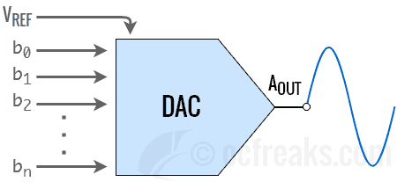
DAC Interfacing with LPC2148
DAC (Digital to Analog Converter)
DAC is a device for converting a digital (usually binary) code to an analog signal (current, voltage or charges)
These are the interface between the abstract digital world and the analog real life.
Simple switches, a network of resistors, current sources or capacitors may implement this conversion.
A DAC inputs a binary number and outputs an analog voltage or current signal.

Slide 23
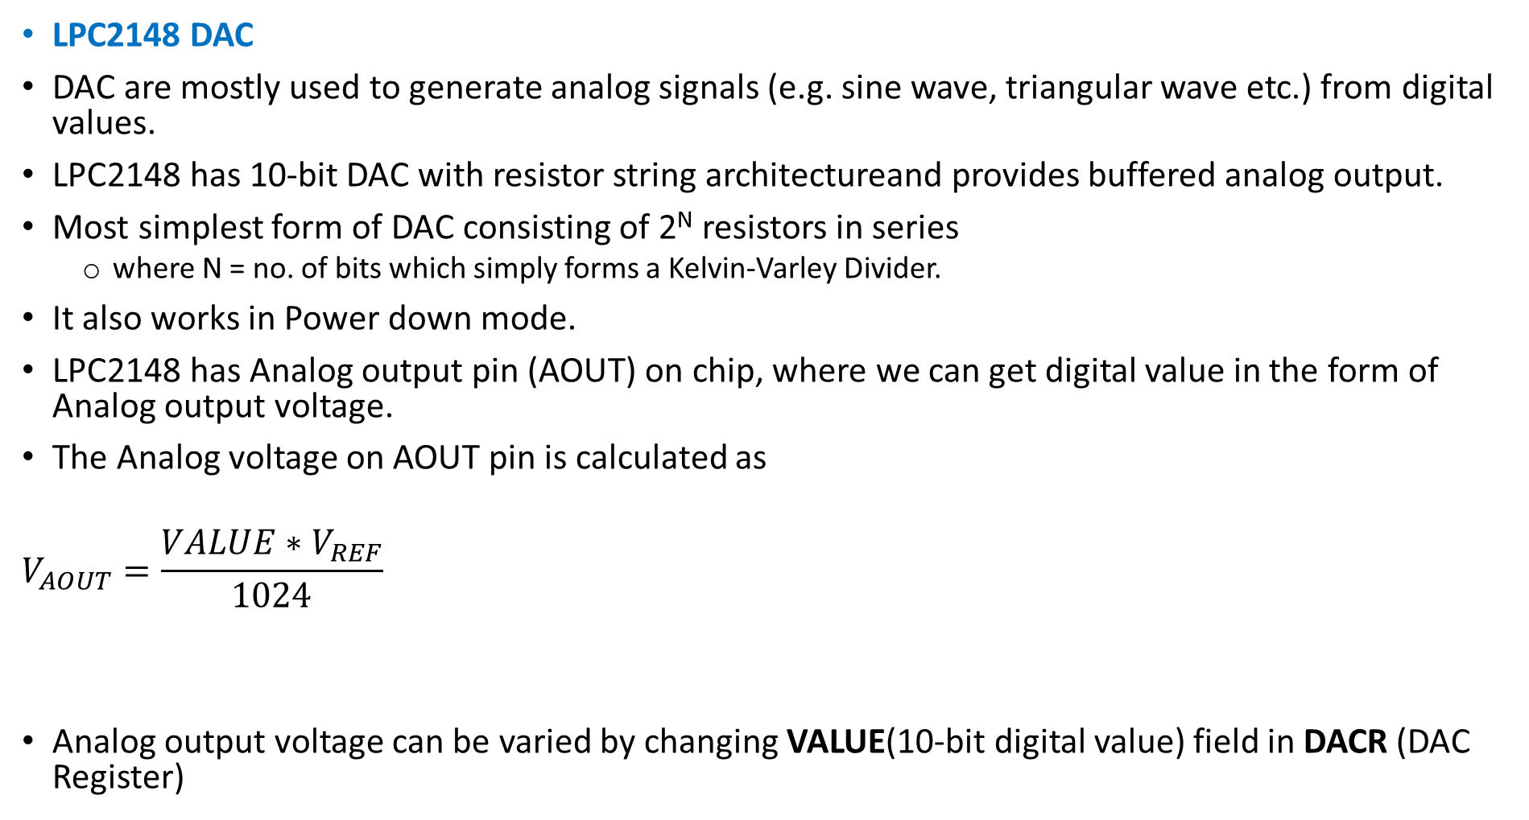
DAC Interfacing with LPC2148
LPC2148 DAC
DAC are mostly used to generate analog signals (e.g. sine wave, triangular wave etc.) from digital values.
LPC2148 has 10-bit DAC with resistor string architectureand provides buffered analog output.
Most simplest form of DAC consisting of 2^{N} resistors in series
where N = no. of bits which simply forms a Kelvin-Varley Divider.
It also works in Power down mode.
LPC2148 has Analog output pin (AOUT) on chip, where we can get digital value in the form of Analog output voltage.
The Analog voltage on AOUT pin is calculated as
$$V_{AOUT}=\frac{VALUE∗V_{REF}}{1024}$$
Analog output voltage can be varied by changing VALUE(10-bit digital value) field in DACR (DAC Register)

Slide 24
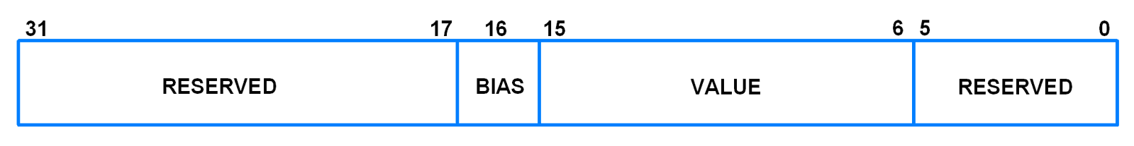
DAC Interfacing with LPC2148
Pins relating to LPC2148 DAC block
DACR register in LPC2148
This register is used to program the DAC block in ARM7 LPC2148.
Bit[5:0]: Reserved.
Bit[15:6] – VALUE: After a new VALUE is written to this field, given settling time selected using BIAS has elapsed, we get the converted Analog voltage at the output
Bit[16] – BIAS:
Setting this bit to 0 selects settling time of 1us max with max current consumption of 700uA.
Setting it to 1 will select settling time of 2.5us but with reduced max current consumption of 350uA.
Bits[31:17]: Reserved
Pin | Description
AOUT (P0.25) | Analog Output pin. Provides the converted Analog signal which is referenced to V_{SSA} i.e. the Analog GND. Set Bits[19:18] in PINSEL1 register to [10] to enable this function.
V_{REF} | This is the voltage reference pin used by DAC for conversion.
V_{DDA}, V_{SSA} | V_{DDA} is Analog Power pin and V_{SSA} is Ground pin used to power the DAC module. These are generally same as V_{DD} and V_{SS} but with additional filtering to reduce noise.

Slide 25
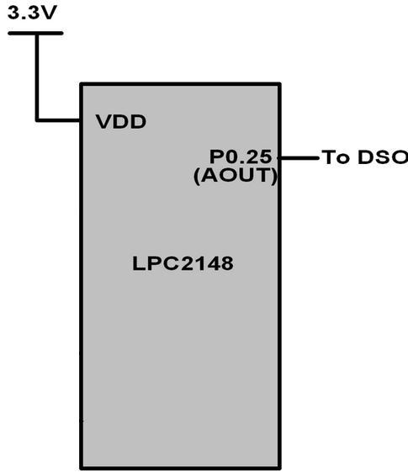
DAC Interfacing with LPC2148
/* Program to generate Square wave*/
#include <lpc2148.h>
#include <stdint.h>
int main (void)
{
int value;
int i;
i = 0;
PINSEL1 = 0x00080000; /* P0.25 as DAC output */
IO0DIR = ( IO0DIR & 0xFFFFFFFF ); /*P0.25 as output pin*/
while(1){
value = 1023;
DACR = ( (1<<16) | (value<<6) );
delay_ms(100);
value = 0;
DACR = ( (1<<16) | (value<<6) );
delay_ms(100);
}
return 0;
}
void delay_ms(uint16_t j)
{
int x,i;
for(i=0; i<j; i++)
{
for(x=0; x<6000; x++);
}
}

Slide 26
DAC Interfacing with LPC2148
/* Program to generate Triangular wave*/
#include <lpc2148.h>
#include <stdint.h>
int main (void)
{
int value=0;
PINSEL1 = 0x00080000; /* P0.25 as DAC output */
IO0DIR = ( IO0DIR & 0xFFFFFFFF ); /*P0.25 as output pin*/
while(1)
{
while ( value != 1023 )
{
DACR = ( (1<<16) | (value<<6) );
value++;
}
while ( value != 0 )
{
DACR = ( (1<<16) | (value<<6) );
value--;
}
}
return 0;
}

Slide 27
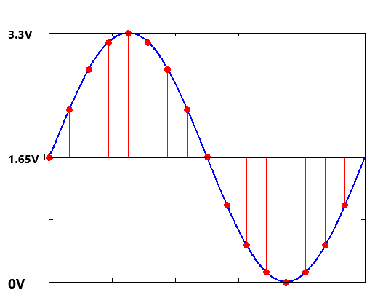


DAC Interfacing with LPC2148
/* Program to generate sine wave*/
Angle(θ) | VALUE
0 | 512
10 | 601
20 | 687
30 | 768
40 | 841
50 | 904
60 | 955
70 | 993
80 | 1016
90 | 1024
100 | 1016
. | .
. | .
360 | 512
V_{AOUT}=1.65 + 1.65 sinθ
$$V_{AOUT}=\frac{VALUE∗V_{REF}}{1024}$$
$$VALUE=\frac{1024∗(1.65+1.65 sinθ)}{3.3}$$

Slide 28
DAC Interfacing with LPC2148
/* Program to generate sine wave*/
#include <lpc2148.h>
#include <stdint.h>
int main (void)
{
int i=0;
PINSEL1 = 0x00080000; /* P0.25 as DAC output */
IO0DIR = ( IO0DIR & 0xFFFFFFFF ); /* P0.25 as output pin */
int sin_wave[36]={512, 601, 687, 768, 841, 904, 955, 993, 1016, 1024, 1016, 993, 955, 904, 841, 768, 687, 601, 512, 423, 337, 256, 183, 120, 69, 31, 8, 0, 8, 31, 69, 120, 183, 256, 337, 423};
while(1)
{
while(i !=36)
{
value = sin_wave[i];
DACR = ( (1<<16) | (value<<6) );
delay_ms(1);
i++;
}
i = 0;
}
return 0;
}

Slide 29
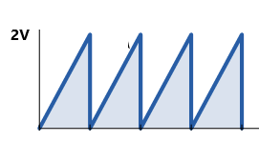
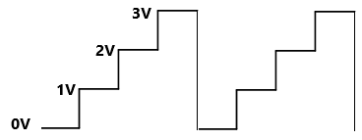
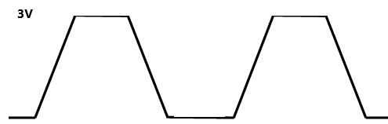
DAC Interfacing with LPC2148
Interface 3 switches to P0.0-P0.2 port lines of LPC2148 microcontroller. Write an assembly language program to generate the fallowing waveforms using internal DAC as per the condition mentioned.
Saw tooth wave SW1 is closed
Stair case wave when SW2 is closed
Trapezoidal wave when SW3 is closed

Slide 30
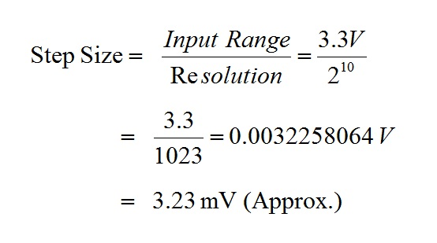
ADC Interfacing with LPC2148
ADC is used to convert analog voltage into its equivalent digital number
Resolution: Indicates the number of digital values.
LPC2148 microcontroller has in-built 10-bit ADC
So for 10-bit ADC resolution is 10-bit and maximum value will be 2¹⁰=1024.
The digital value or discrete level lies between 0 to 1023
Step size: It is the minimum change in input voltage which can be resolved by ADC.

Slide 31
ADC Interfacing with LPC2148
The ADC in LPC2148 is 10-bit successive approximation analog to digital converter.
The features are listed as:
LPC2148 has two inbuilt ADC Modules, named as ADC0 & ADC1.
ADC0 has 6-Channels (AD0.1-AD0.6).
ADC1 has 8-Channels (AD1.0-AD1.7).
ADC operating frequency is 4.5 MHz (max.), operating frequency decides the conversion time.
Supports power down mode.
Burst conversion mode for single or multiple inputs.
Both ADCs convert analog signals in the range of 0V to VREF (typically 3V; not to exceed VDDA voltage level).

Slide 32
ADC Interfacing with LPC2148
 | ADC Channel | Port Pin | Pin No. | Pin Functions | Associated PINSEL Register
ADC0 | AD0.1 | P0.28 | 13 | 0-GPIO, 1-AD0.1, 2-CAP0.2, MAT0.2 | 24,25 bits of PINSEL1
 | AD0.2 | P0.29 | 14 | 0-GPIO, 1-AD0.2, 2-CAP0.3, 3-MAT0.3 | 26,27 bits of PINSEL1
 | AD0.3 | P0.30 | 15 | 0-GPIO, 1-AD0.3, 2-EINT3, 3-CAP0.0 | 28,29 bits of PINSEL1
 | AD0.4 | P0.25 | 9 | 0-GPIO, 1-AD0.4, 2-AOUT, | 18,19 bits of PINSEL1
 | AD0.6 | P0.4 | 27 | 0-GPIO, 1-SCK0, 2-CAP0.1 , 3-AD0.6 | 08,09 bits of PINSEL0
 | AD0.7 | P0.5 | 29 | 0-GPIO, 1-MISO0, 2-MAT0.1 , 3-AD0.7 | 10,11 bits of PINSEL0
ADC1 | AD1.0 | P0.6 | 30 | 0-GPIO, 1-MOSI0, 2-CAP0.2, 3-AD1.0 | 12,13 bits of PINSEL0
 | AD1.1 | P0.8 | 33 | 0-GPIO, 1-TXD1, 2-PWM4, 3-AD1.1 | 16,17 bits of PINSEL0
 | AD1.2 | P0.10 | 35 | 0-GPIO, 1-RTS1, 2-CAP1.0, 3-AD1.2 | 20,21 bits of PINSEL1
 | AD1.3 | P0.12 | 38 | 0-GPIO, 1-DSR1, 2-MAT1.0, 3-AD1.3 | 24,25 bits of PINSEL1
 | AD1.4 | P0.13 | 39 | 0-GPIO, 1-DTR1, 2-MAT1.1 , 3-AD1.4 | 26,27 bits of PINSEL3
 | AD1.5 | P0.15 | 45 | 0-GPIO, 1-RI1, 2-EINT2 , 3-AD1.5 | 30,31 bits of PINSEL3
 | AD1.6 | P0.21 | 1 | 0-GPIO, 1-PWM5, 2-AD1.6, 3-CAP1.3 | 10,11 bits of PINSEL1
 | AD1.7 | P0.22 | 2 | 0-GPIO, 1-AD1.7, 2-CAP0.0, 3-MAT0.0 | 12,13 bits of PINSEL1

Slide 33
ADC Interfacing with LPC2148
ADC Registers
Table shows the registers associated with LPC1768 ADC.
Focus only on ADCR and ADGDR as these are sufficient for simple A/D conversion.
Register Name | Function
ADxCR | A/D Control Register: The ADCR register must be written to select the operating mode before A/D conversion can occurs.
ADxGDR | A/D Global Data Register: This register contains ADC’s DONE bit and the result of the most recent A/D conversion.
ADxSTAT | A/D Status Register: This register contains DONE and OVERRUN flag for all the A/D Channels, as well as the A/D interrupt flag.
ADGSR | A/D Global Start Register: This address can be written (in the AD0 address range) to start conversions in both A/D converters simultaneously.
ADxINTEN | A/D Interrupt Enable Register: This register contains enable bits that allow the DONE flag of each A/D channel to be included or excluded from contributing to the generation of an A/D interrupt.
ADxDR0-ADxDR7 | A/D Channel Data Register: Contains the recent ADC value for respective channel ‘x’ is 0 or 1

Slide 34
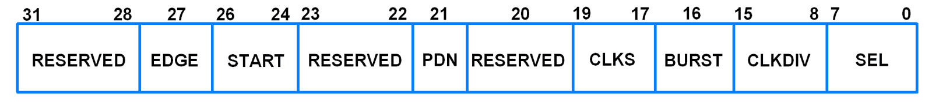
ADC Interfacing with LPC2148
A/D Control Register (AD0CR and AD1CR)
Used to control and monitors the ADC operation.
ADxCR is a 32-bit register.
This register must be written to select the operating mode before A/D conversion can occur.
It is used for selecting:
channel of ADC
clock frequency for ADC
number of clocks or number of bits in result
start of conversion and few other parameters.

Slide 35
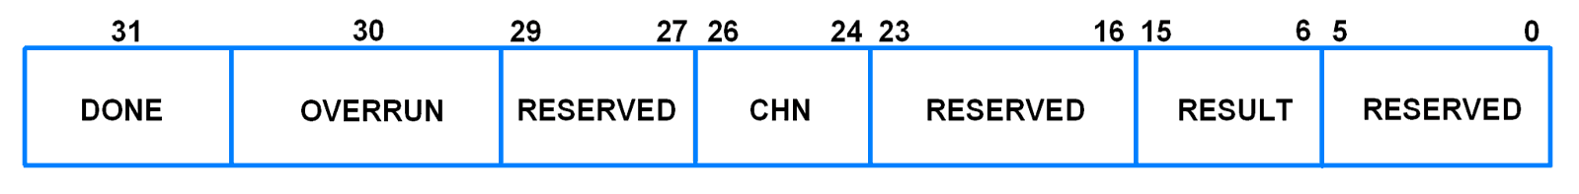
ADC Interfacing with LPC2148
A/D Global Data Register (AD0GDR and AD1GDR)
AD0GDR is a 32-bit register.
This register contains the ADC’s DONE bit and the result of the most recent A/D conversion.

Slide 36
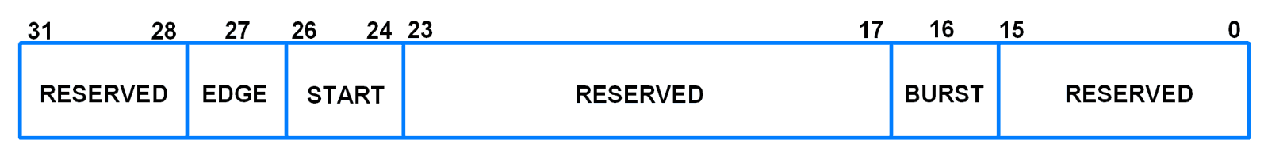
ADC Interfacing with LPC2148
A/D Global Start Register (ADGSR)
ADGSR is a 32-bit register.
Software can write to this register to simultaneously start conversions on both ADC.
BURST (Bit 16), START (Bit <26:24>) & EDGE (Bit 27)
These bits have same function as in the individual ADC control registers i.e. AD0CR & AD1CR. Only difference is that we can use these function for both ADC commonly from this register.

Slide 37
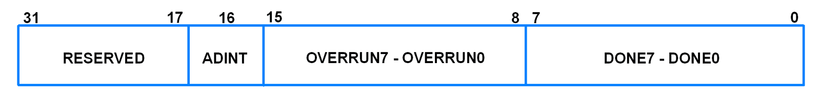
ADC Interfacing with LPC2148
A/D Status Register (ADC0:AD0STAT and ADC1:AD1STAT)
AD0STAT is a 32-bit register.
It allows checking of status of all the A/D channels simultaneously.
Bit 7:0 – DONE7:DONE0
These bits reflect the DONE status flag from the result registers for A/D channel 7 - channel 0.
Bit 15:8 – OVERRUN7:OVERRUN0
These bits reflect the OVERRUN status flag from the result registers for A/D channel 7-channel 0.
Bit 16 – ADINT
This bit is 1 when any of the individual A/D channel DONE flags is asserted and enables ADC interrupt if any of interrupt is enabled in AD0INTEN register.
Bit 31:17 – RESERVED

Slide 38
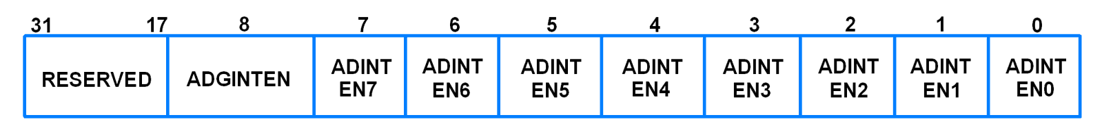
ADC Interfacing with LPC2148
A/D Interrupt Enable (ADC0:AD0INTEN and ADC1:AD1INTEN)
AD0INTEN is a 32-bit register.
It allows control over which channels generate an interrupt when conversion is completed.
Bit 0 – ADINTEN0
0 = Completion of a A/D conversion on ADC channel 0 will not generate an interrupt
1 = Completion of a conversion on ADC channel 0 will generate an interrupt
Remaining ADINTEN bits have similar description as given for ADINTEN0.
Bit 8 – ADGINTEN
0 = Only the individual ADC channels enabled by ADINTEN7:0 will generate interrupts
1 = Only the global DONE flag in A/D Data Register is enabled to generate an interrupt

Slide 39
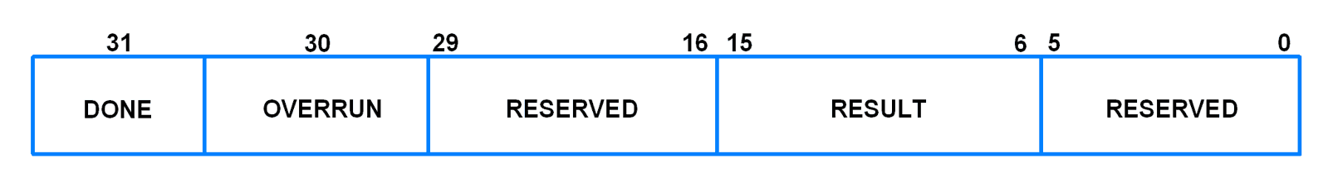
ADC Interfacing with LPC2148
A/D Data Registers (ADC0:AD0DR0-AD0DR7 and ADC1:AD1DR0-AD1DR7)
These are 32-bit registers.
They hold the result when A/D conversion is completed.
They also include flags that indicate when a conversion has been completed and when a conversion overrun has occurred.
Bit 5:0 – RESERVED
Bits 15:6 – RESULT
When DONE bit is set to 1, this field contains 10-bit ADC result that has a value in the range of 0 (less than or equal to VSSA) to 1023 (greater than or equal to VREF).
Bit 29:16 – RESERVED
Bit 30 – Overrun
This bit is set to 1 in burst mode if the result of one or more conversions is lost and overwritten before the conversion that produced the result in the RESULT bits.
This bit is cleared by reading this register.
Bit 31 – DONE
This bit is set to 1 when an A/D conversion completes. It is cleared when this register is read

Slide 40
Introduction to LPC2148 Microcontroller
ADC Operating modes in LPC214x :
Software controlled mode : In Software mode
only one conversion will be done at a time
conversion can be controlled in software.
To perform another conversion you will need to re-initiate the process.
In software mode only 1 bit in the SEL field of AD0CR can be 1 i.e. only 1 Channel(i.e. Pin) can be selected for conversion at a time. You can do conversions on multiple Channels (one at a time) by selecting a particular Channel along with appropriate bit in SEL field and then do the same for rest of the channels.
Burst or Hardware mode :
conversions are performed continuously on the selected channels in round-robin fashion.
Overrun may occur in this mode
Overrun is the case when a previous conversion result is replaced by new conversion result without previous result being read i.e. the conversion is lost.
Usually an interrupt is used in Burst mode to get the latest conversion results. This interrupt is triggered when conversion in one of the selected channel ends.

Slide 41
ADC Interfacing with LPC2148
Steps for Analog to Digital Conversion
Configure the ADxCR (A/D Control Register) according to the need of application.
Start A/D conversion by writing appropriate value to START bits in ADxCR.
Monitor the DONE bit (bit number 31) of the corresponding ADxDRy (A/D Data Register) till it changes from 0 to 1. This signals completion of conversion. We can also monitor DONE bit of ADGSR or the DONE bit corresponding to the ADC channel in the ADCxSTAT register.
Read the ADC result from the corresponding A/D Data Register: ADxDRy.
Example: AD0DR1 contains ADC result of channel 1 of ADC0.

Slide 42
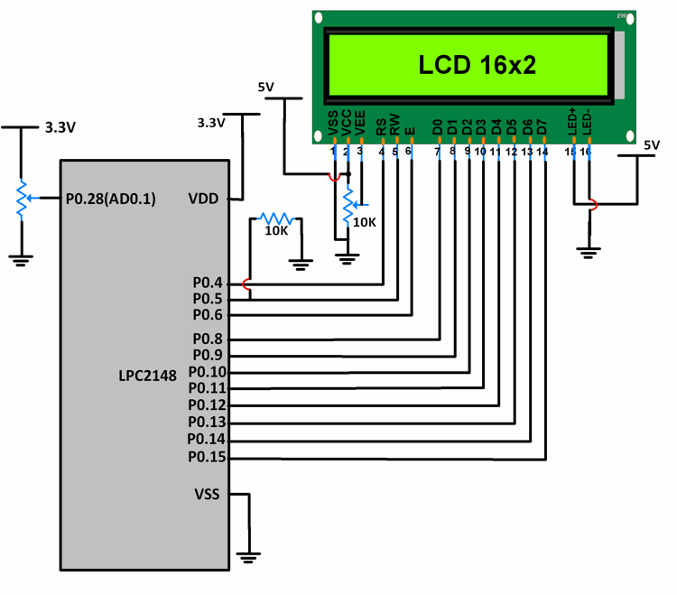
ADC Interfacing with LPC2148
Input signal is a DC signal which varies from 0 to 3.3V via a potentiometer.
Signal is given on P0.28.
P0.28 is configured as AD0.1 using PINSEL register.
10-bit ADC result is stored in a variable and its lower 8 bits are given to P0.8-P0.15. These pins are connected to the data pins of an LCD.
P0.4,5,6 are used as RS, RW, EN pins of the LCD.
As the potentiometer is varied, we can see the variation in equivalent voltage value on the LCD.

Slide 43
ADC Interfacing with LPC2148
#include <lpc214x.h>
#include <stdio.h>
#include <stdint.h>
#include <string.h>
void delay_ms(int j) /* Function for delay in milliseconds */
{
int x,i;
for(i=0;i<j;i++)
{
for(x=0; x<6000; x++); /* loop to generate 1 millisecond delay with Cclk = 60MHz */
}
}

Slide 44
ADC Interfacing with LPC2148
void LCD_CMD(char command)
{
IO0PIN = ( (IO0PIN & 0xFFFF00FF) | (command<<8) ); /* Put command on data pins */
delay_ms(2);
IO0SET = 0x00000040; /* EN = 1 */
IO0CLR = 0x00000030; /* RS = 0, RW = 0 */
delay_ms(2);
IO0CLR = 0x00000040; /* EN = 0, RS and RW unchaned(i.e. RS = RW = 0) */
delay_ms(5);
}
void LCD_INIT(void)
{
IO0DIR = 0x0000FFF0; /* P0.8 to P0.15 LCD Data. P0.4,5,6 as RS RW and EN */
delay_ms(20);
LCD_CMD(0x38); /* Initialize lcd */
LCD_CMD(0x0C); /* Display on cursor off */
LCD_CMD(0x06); /* Auto increment cursor */
LCD_CMD(0x01); /* Display clear */
LCD_CMD(0x80); /* First line first position */
}

Slide 45
ADC Interfacing with LPC2148
void LCD_CHAR(char msg)
{
IO0PIN = ( (IO0PIN & 0xFFFF00FF) | (msg<<8) ); /* Put msg on data pins */
delay_ms(2);
IO0SET = 0x00000050; /* RS = 1, , EN = 1 */
IO0CLR = 0x00000020; /* RW = 0 */
delay_ms(2);
IO0CLR = 0x00000040; /* EN = 0, RS and RW unchanged(i.e. RS = 1, RW = 0) */
delay_ms(5);
}

Slide 46
ADC Interfacing with LPC2148
int main(void)
{
int result,i=0;
float voltage;
char volt[18];
LCD_INIT();
PINSEL1 = 0x01000000; /* P0.28 as AD0.1 */
AD0CR = 0x00200402; /* ADC operational, 10-bits, 11 clocks for conversion */
while(1){
AD0CR = AD0CR | (1<<24); /* Start Conversion */
while ( !(AD0DR1 & 0x80000000) ); /* Wait till DONE */
result = AD0DR1;
result = (result>>6);
result = (result & 0x000003FF);
voltage = ( (result/1023.0) * 3.3 ); /* Convert ADC value to equivalent voltage */

Slide 47
ADC Interfacing with LPC2148
result = (result & 0x000003FF);
voltage = ( (result/1023.0) * 3.3 ); /* Convert ADC value to equivalent voltage */
sprintf(volt, "Voltage=%.2f V ", voltage);
while(volt[i]!='\0')
{
LCD_CHAR(volt[i]);
i++;
}
}
}

